Slide 1

Unreal engine advnced
Default Maps

Slide 2

Changing the default level
In the editor, you can change a number of settings specific to your project.
That includes being able to set the Level that your project's players will load into.
In addition to the default game Level, you can set a default editor Level to speed up your workflow by immediately loading into a Level you work on frequently.

Slide 3
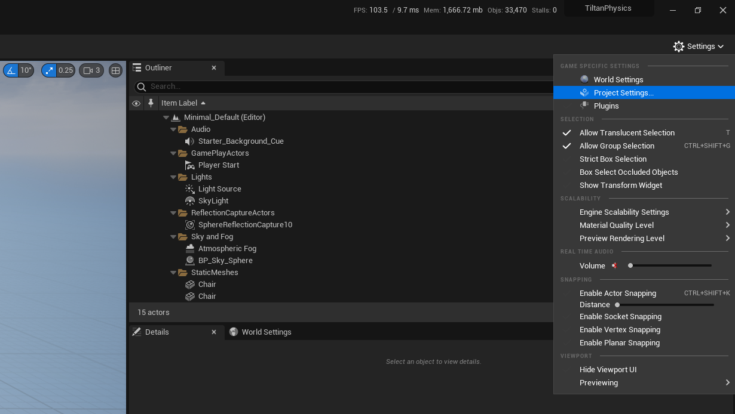
Changing the default level

Slide 4
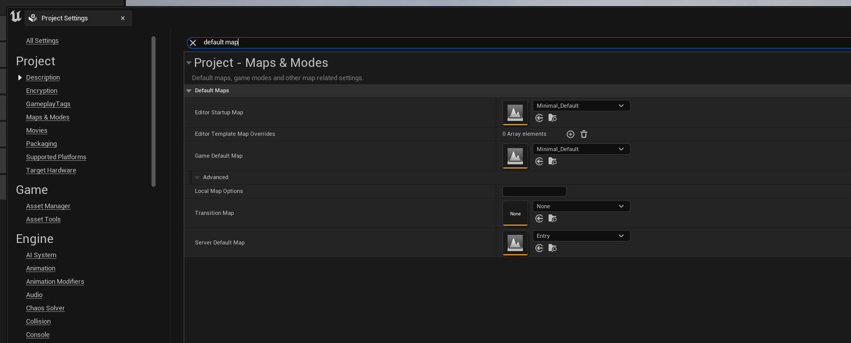


Changing the default level

Slide 5

Resources
https://docs.unrealengine.com/5.0/en-US/changing-the-default-level-of-an-unreal-engine-project/

Slide 6
Thank you!
Best of luck!

